Slide 1
A predictive tool for identifying flights delayed in arrival
Alicia Korol
Data Scientist III | Candidate Evaluation
November 29, 2021

Slide 2
Overview
Problem statement & objective
Data sets
Variable selection
Variable preprocessing
Model selection
Setting model parameters
Model results & performance
Importance of predictors
Sample instructions for software engineering team

Slide 3
Problem statement
Our airline customer has a considerable number of flights that arrive late and seek to understand factors that delay flights for improved service and efficiency
Using historical data provided by the airline, 42% of flights from NYC airports were delayed in a 6-month period
Some reasons for delays from federal aviation administration (https://aspm.faa.gov/) :
Weather, air traffic volume, pilot-related
External interference (e.g., air show, bomb threat, radio frequency disturbance, military operations)
Mechanical issues, runway/taxi closures, equipment failure or outage
Use a statistical model to predict flights that arrive late
Objective

Slide 4
Data sets available for airline
Flight_history.csv – Details on outbound flights from NYC airports from January to June 2013
Flight_test.csv – Randomly selected unique flights from the month of July.

Slide 5
Variables NOT selected for modeling
Variables not selected for modeling either directly or indirectly (via a derived variable)
Data NOT selected for use because variable not in test set & redundant with variable measuring delay of arrival in minutes
Actual departure time
Actual arrive time
Data NOT select for use because of redundancy with other variables
Hour of scheduled depart. time – strong association to scheduled departure time
Date stamp of scheduled depart. time – strong association to month
Data NOT selected for use due to too many categories for a generalizable model
Tail number
Flight number – also no theoretical influence on delays
Data NOT selected for use for other reasons
Year – only 1 value
Unique ID – not a predictor

Slide 6
Variables constructed
Data modified for use because variable not in test set
Data assigned for use because variable not in test set
Distance (between origin and destination) - assigned to test set successfully, with only 2 flights to 1 destination in test set not assigned
Original variable | Constructed variable 1 | Constructed variable 2 | Constructed variable 3 | Constructed variable 4
Delay of departure (min) | Average delay by day | Percent of flights delayed by carrier | Percent of flights delayed by origin
Delay of arrival (min) | Binary indicator of late flight for historical data set | Average delay by destination | Percent of flights delayed by destination | Percent of flights delayed by carrier
Air-time | Variance of air-time by origin and destination

Slide 7
Variable pre-processing
Numeric variables
Transformations applied to improve normality and reduce influence of outliers
Sqrt transformation: Variance in air-time by origin and destination
Log₁₀ transformation: Distance, percent arrival delay by destination
Variables checked for correlation at 0.9 threshold
Redundant variables removed as indicated previously

Slide 8
Variable pre-processing
Categorical variables
Dummy coding applied to created numeric variables
Creates n-1 number of new binary variables from n categories
Method prevents multicollinearity between newly created variables due to redundancy
Variable with 3 categories
Comparison 1
0
1
Comparison 2
0
1

Slide 9
Model selection
Random forest
Ensemble method with classification decision trees
Details:
Predicts a binary outcome
Decision trees model binary and non-linear data well
Ensemble method creates multiple decision trees on different samples (with replacement) from the data set
The “forest” of trees is “random” because of the individual decision trees is trained with a random selection of possible predictors, which reduces similarity between the trees
Chosen over an even more powerful method – boosted trees – due to quicker performance speed

Slide 10
Setting model parameters
Random Forest has three parameters that can be adjusted to optimize performance (tuned)
Minimum data needed in a branch
Parameter set by tuning
Number of predictors used at each branching point (node)
Number of predictors should be somewhere between 1 and n total numbers of predictors
Recommended default is sqrt of number of predictors
Parameter could be tuned, but instead was set to 20 to reduce run time
Number of trees to create
Parameters could be tuned, but more trees are generally better
Parameter set to 500

Slide 11
Tuning model parameters
Parameter tuning
Random generation of parameter combination set
Random results over systematic selection have been demonstrated to perform better
For only 1 parameter, 5 different values were randomly generated for evaluation of minimum data needed in each branch
K-fold cross validation
Method to compare model performance using training set (historical data set) only
Model performance determined used K different subsets of the training set for validation purposes
K set to 3, thus model performance was estimated from three different validations on the training set
Best performing value = 26

Slide 12
Model results & performance
Confusion Matrix
Model correctly estimated flights with delayed arrival in 51.5 % of cases (sensitivity)
Model correctly estimated flights not delayed on arrival in 65.7 % of cases (specificity)
Truth
 | Yes | No
Yes | 1,387 | 916
No | 1,308 | 2,170
Predicted

Slide 13
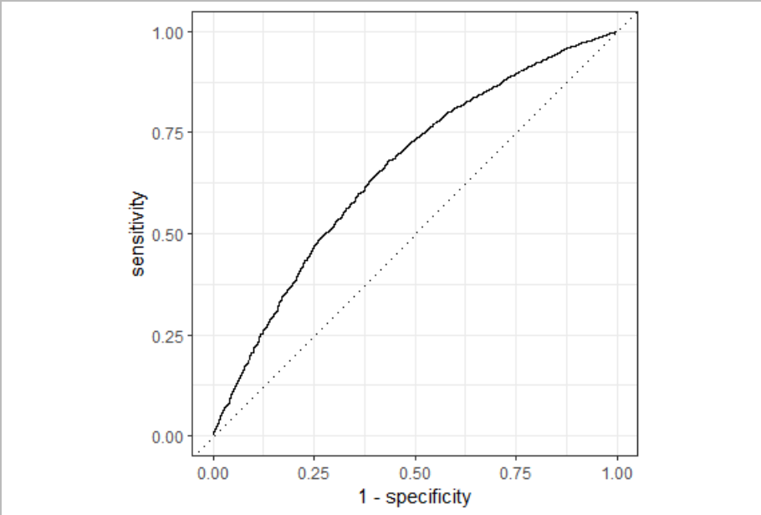
Model results & performance
Receiver Operating Characteristic (ROC) curve
Plot of sensitivity by 1-specificity across all probability cutoff values (e.g., 0.05, .40, .50, .80, .98) of predicting a late flight
Performance metric = area under the curve (AUC)
ROC-AUC values range 0-1, with 1 indicating that data is estimated perfectly
ROC – AUC = 0.66
Cutoff value (C):
Probability <= C, then outcome prediction is No
Probability > C, then outcome prediction is Yes

Slide 14
Adjusting cutoff to reduce false negatives
When flights truly arrive late, the model can only predict the late flight in 51.5% of cases, which is no better than guessing at random.
Model sensitivity = .515, cutoff = .50
Model specificity = .703, cutoff = .50
Specificity > sensitivity partly due to outcome imbalance
No/Yes observations: 93k/67k
Models tend to optimize for majority class
Adjusting cutoff value
40% cutoff value:
Model sensitivity = .678, specificity = .567
Can tune using other performance metrics
Accuracy
F₁
Cutoff = .5
Cutoff = .4

Slide 15
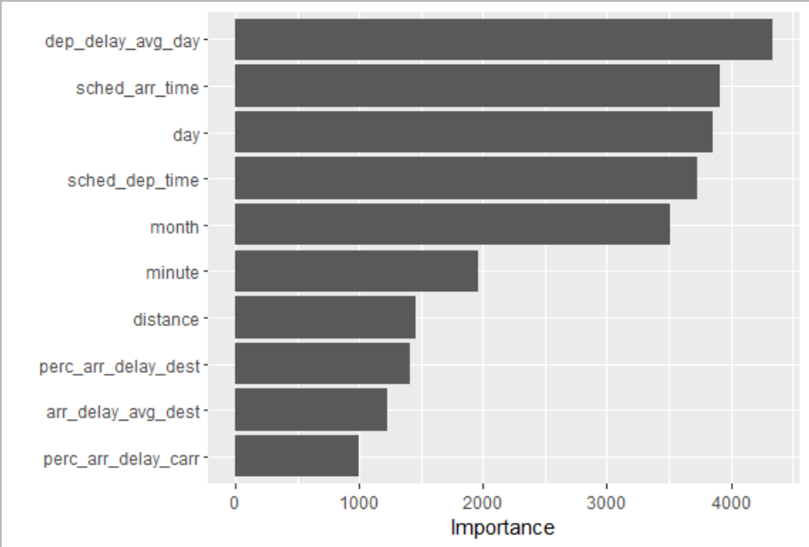
Importance of predictors
Gini importance metric
for classification models, akin to the cumulative decrease in residual sum of squares across all nodes for a predictor, where relative magnitude is interpreted but not scale
Conclusion: Top 6 predictors are time-related
Origin, destination, and carrier were less important
Time-related reasons for delay, e.g., weather, air-traffic volume, or pilot-related issues may have significant impact on delays

Slide 16
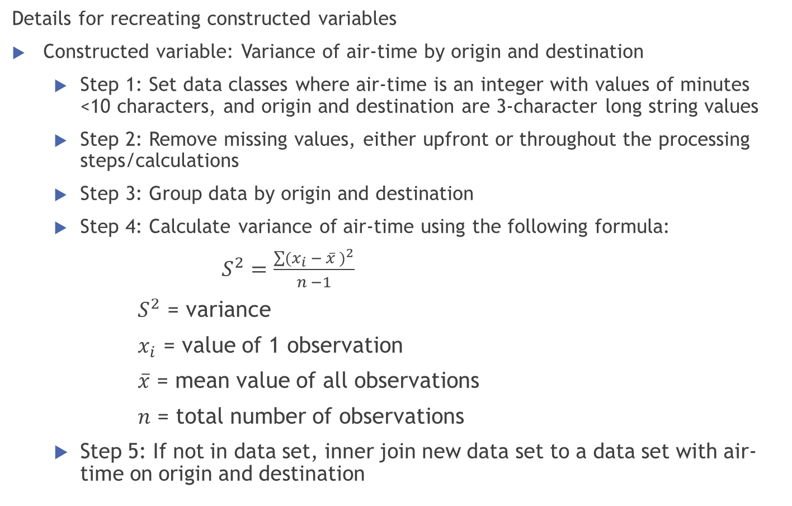
Sample instructions for software engineers
Details for recreating constructed variables
Constructed variable: Variance of air-time by origin and destination
Step 1: Set data classes where air-time is an integer with values of minutes <10 characters, and origin and destination are 3-character long string values
Step 2: Remove missing values, either upfront or throughout the processing steps/calculations
Step 3: Group data by origin and destination
Step 4: Calculate variance of air-time using the following formula:
$S^{2}=\frac{\sum{{(x_{i} − \overline{x} )}^{2}}}{n −1}$
$S^{2}$ = variance
$x_{i}$ = value of 1 observation
$\overline{x}$ = mean value of all observations
$n$ = total number of observations
Step 5: If not in data set, inner join new data set to a data set with air-time on origin and destination

Slide 17
Thank you for your time and interest!

